Slide 1
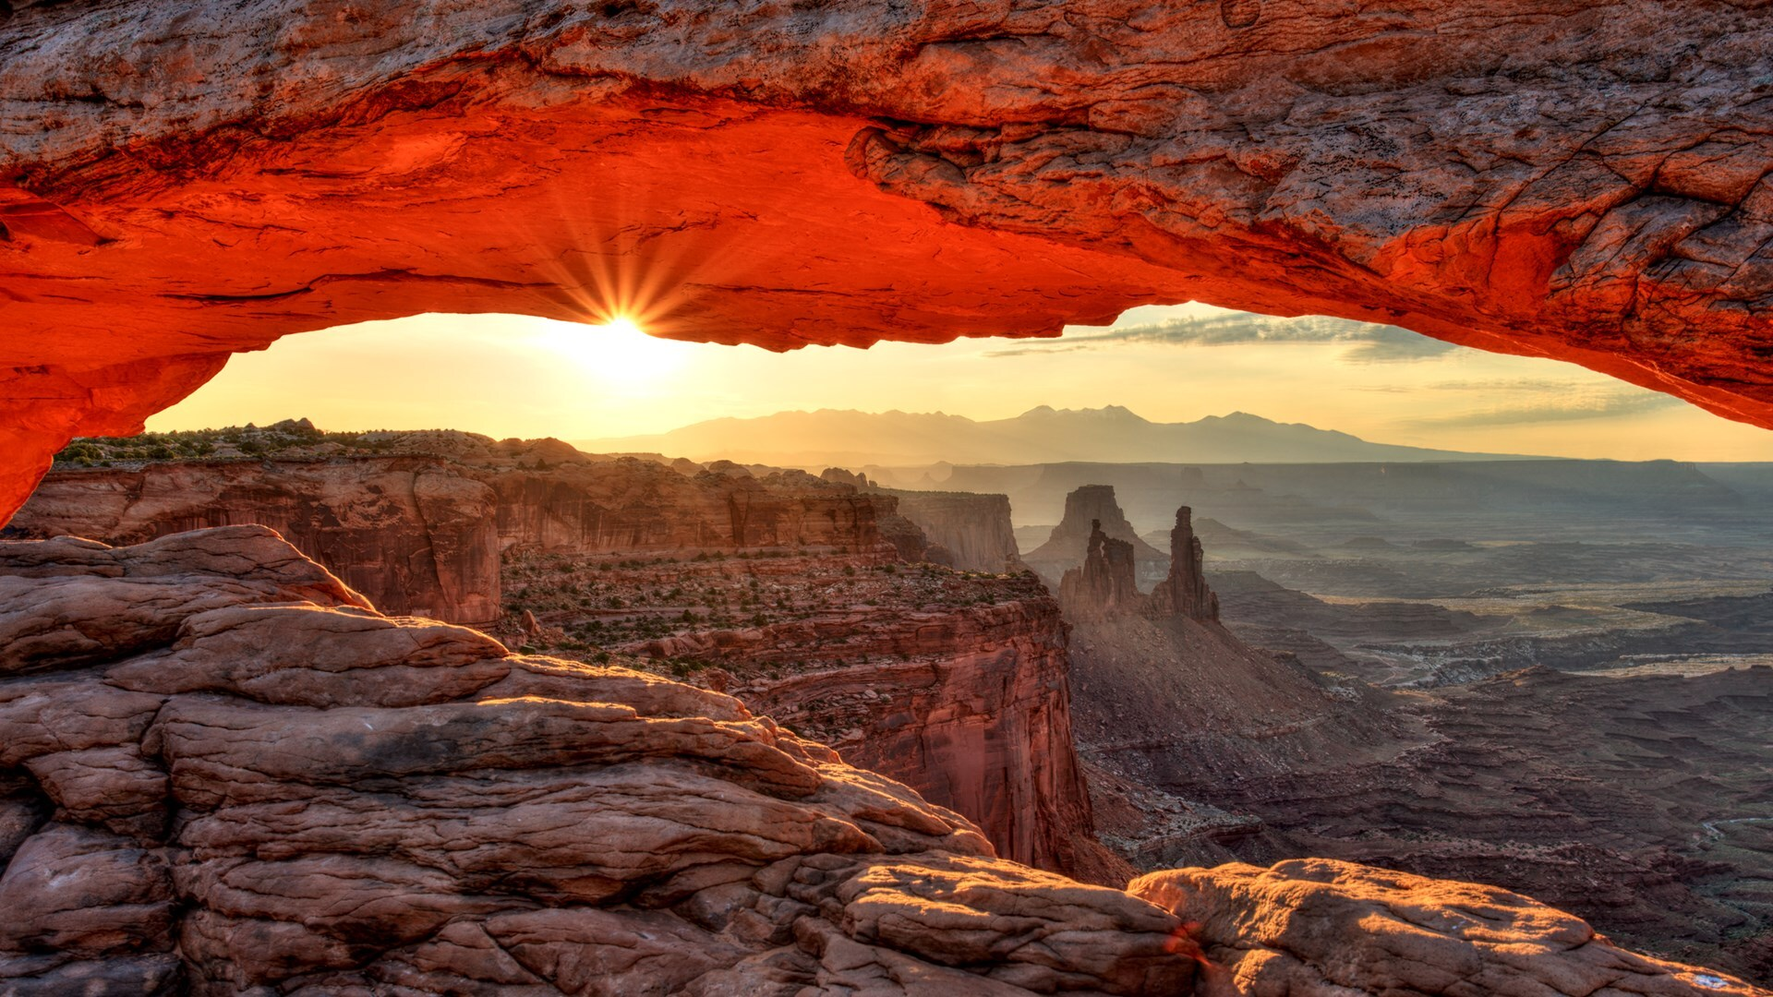
RoamForth

Slide 2
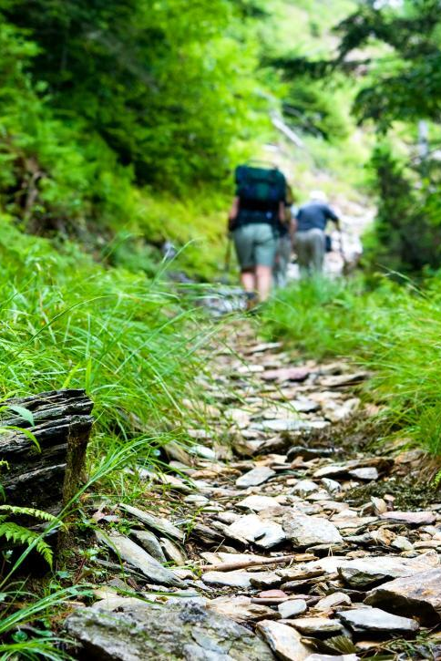
Collaborators:
Project Manager: Jaime Harman
Javascript Enthusiast/API Master: Danny Steiger
Technical Support/ReadMe.md writer: Oscar Oses
Github Guru/PowerPoint Dev: Jeremiah Weatherspoon

Slide 3
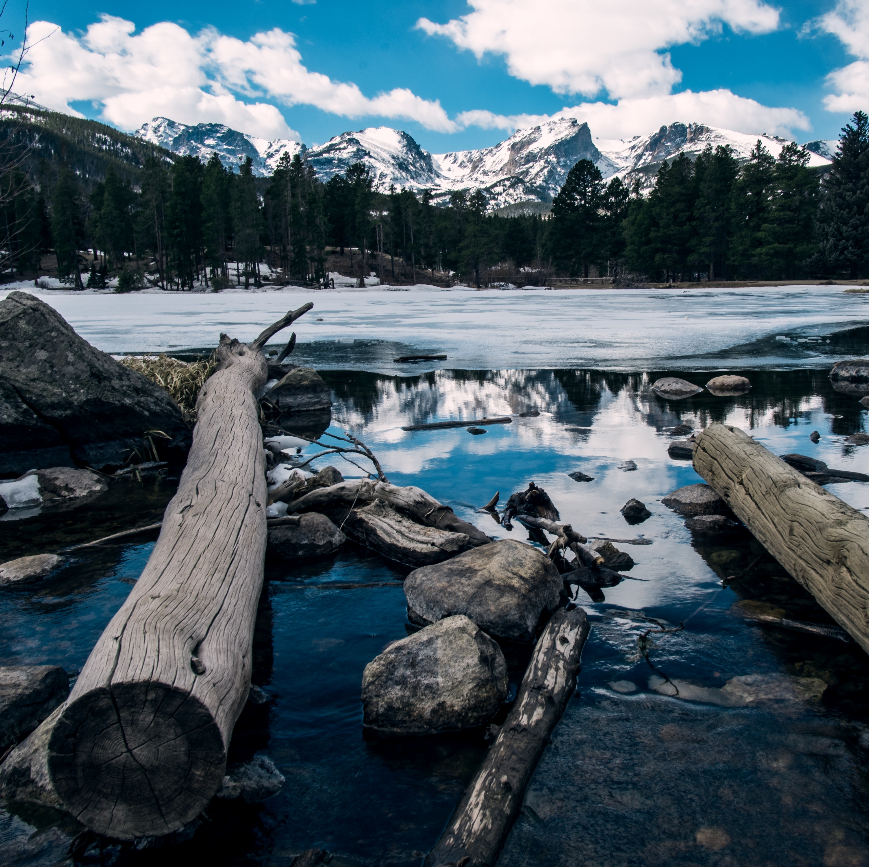
Speakers:
Ebb & Flow (Powerpoint): Jaime
Visual Code(r) (HTML & CSS): Jaime
Javascript Enthusiasts: Oscar and Danny
Site User (Live Site): Jeremiah

Slide 4

Why did we develop it?
With the Covid19 Pandemic, people are unable to travel or gather in many public places while still maintaining social distancing. This application allows lovers of nature and those looking to explore the national parks an opportunity to view activities. This will help them prepare for their visit.

Slide 5
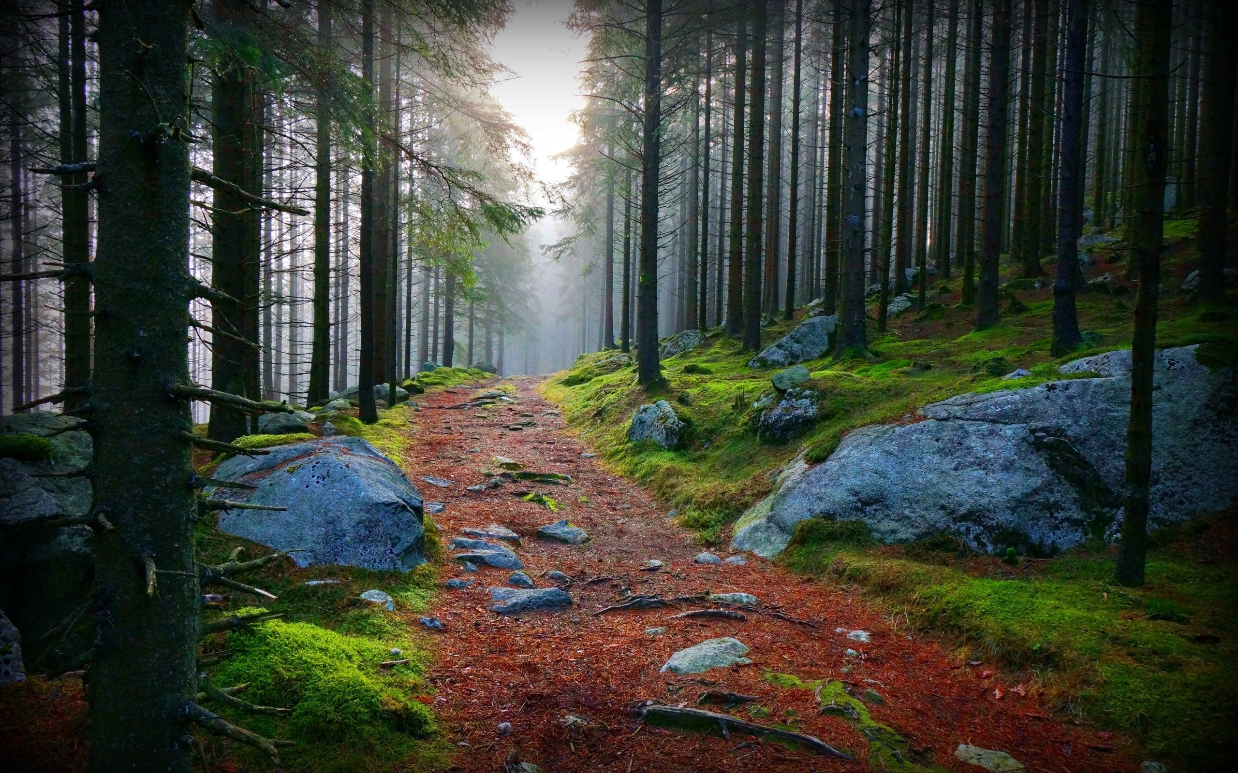
Technologies that were used:
Materialize
JavaScript
Modals
jQuery
National Parks Service API
Mapquest API

Slide 6
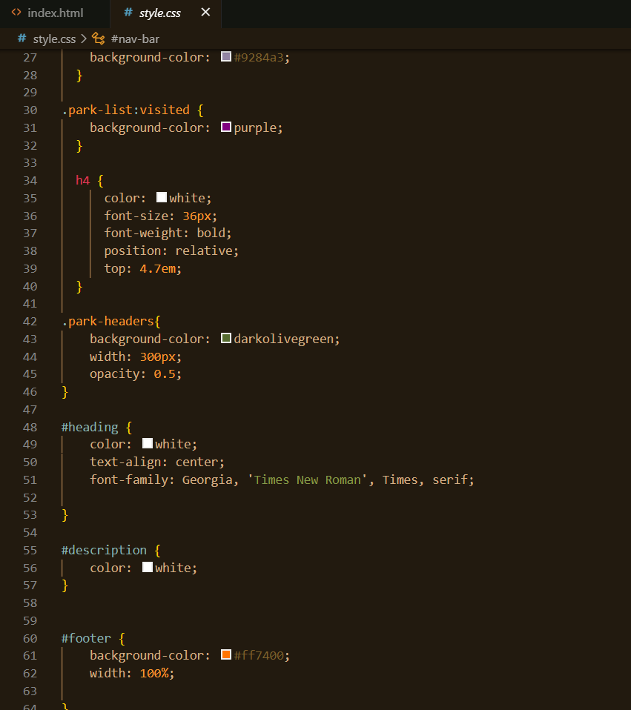
Screenshots of CSS:

Slide 7
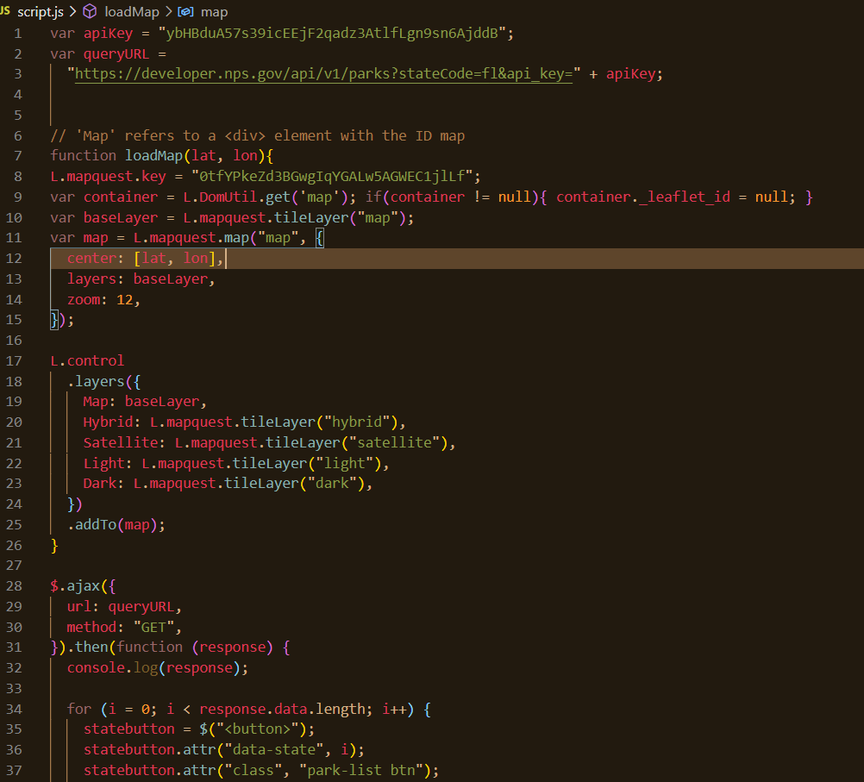
Screenshots of JavaScript:

Slide 8
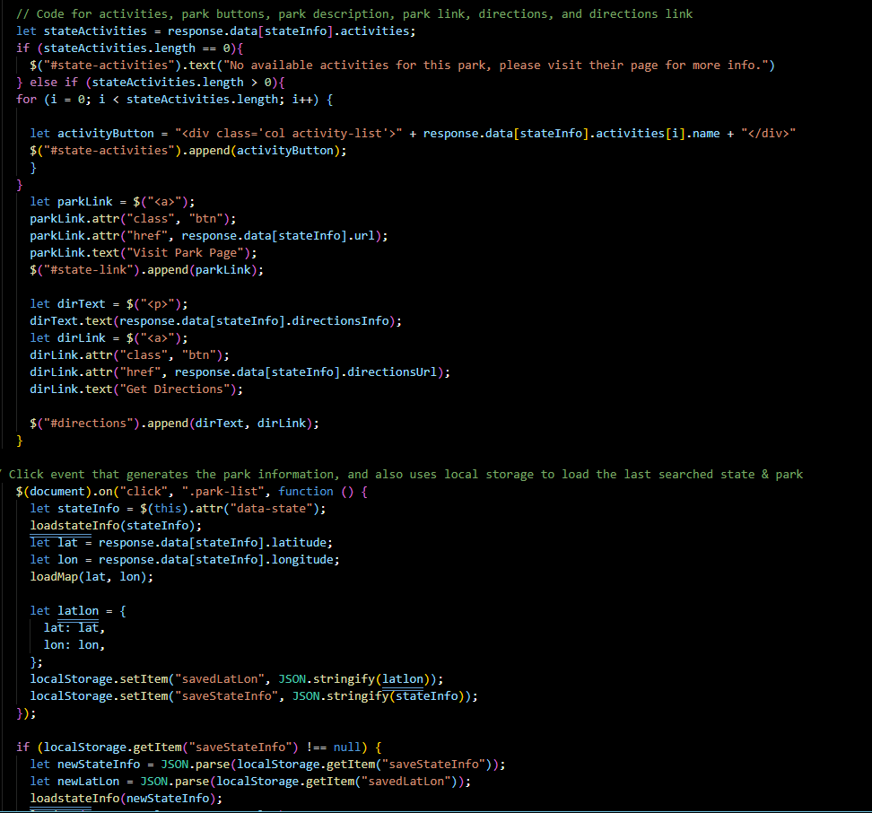
Additional JavaScript Code Screenshot

Slide 9
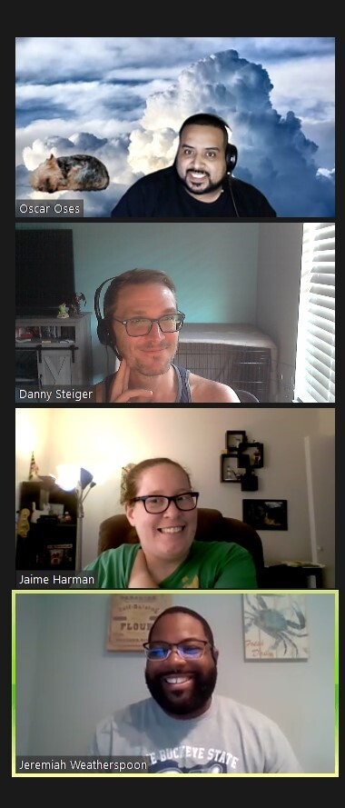
Screen shots of the project in early development:
At the beginning, we had other ideas but had a really hard time finding APIs for the project!
This project was a third attempt! Due to Danny’s API diligence, he was able to find our current APIs and we were able to formulate a viable plan!!

Slide 10
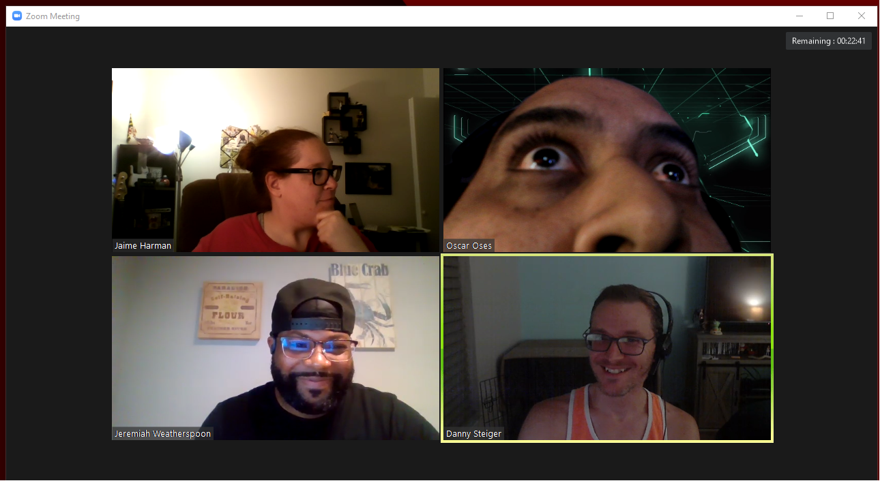
Screenshot of project mid-development below:
Hitting some stress points!
Issues:
GitHub merge conflicts
Carousel issues
Activities display

Slide 11
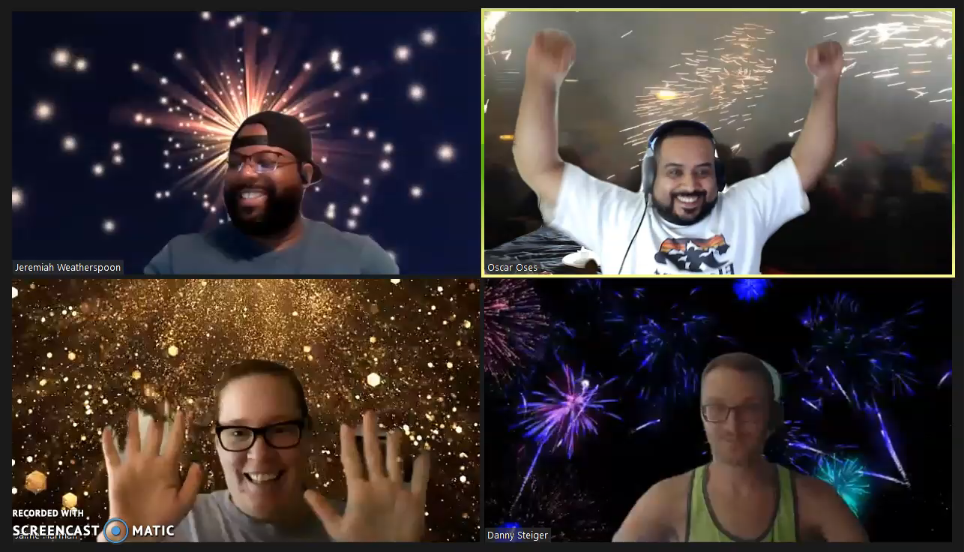
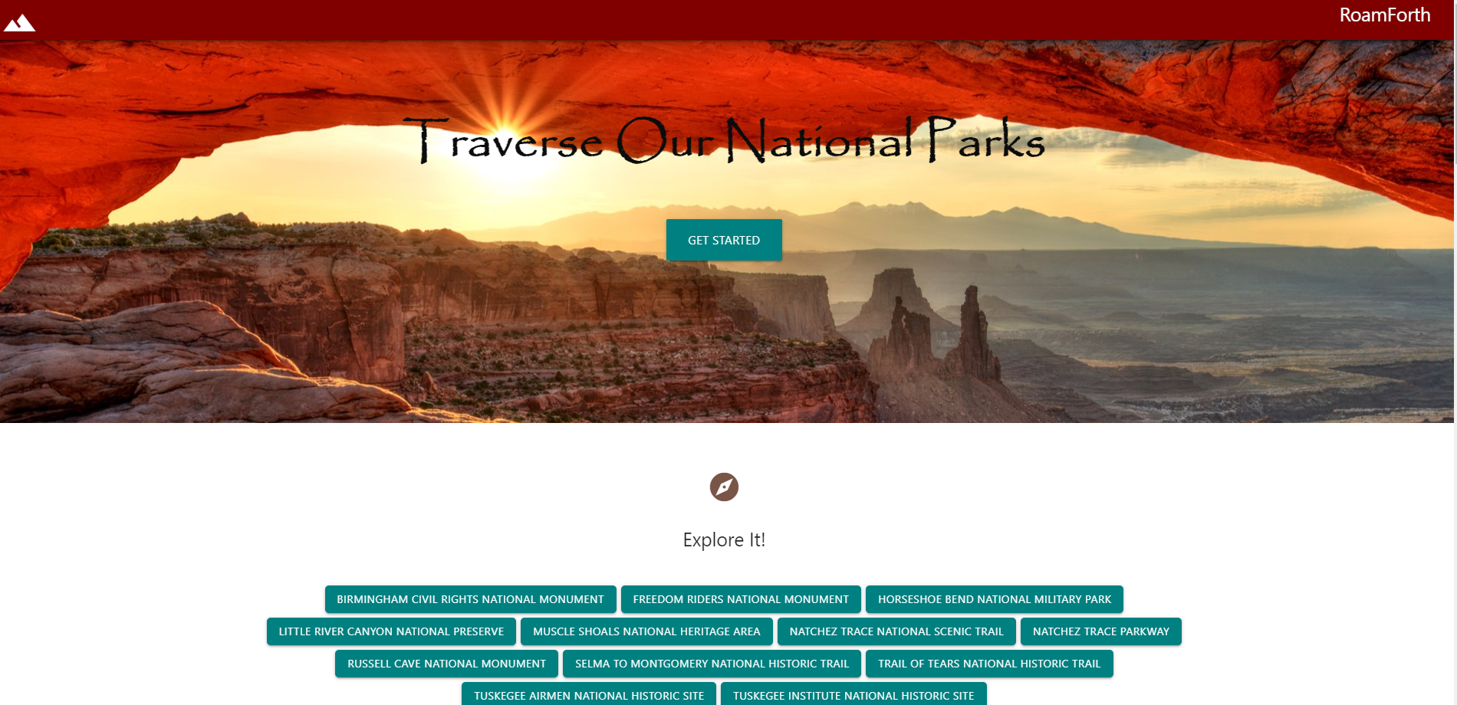
Screenshot of final part of project and a working live site:

Slide 12

Future Development
User can click on the map and it would offer a road trip feature to visit all parks in the state
Make the application more interactive for the user: save parks visited, click on activities, etc.
Connect to webcams which allows user to visit virtually.

Slide 13





Jeremiah will demo the “RoamForth” Live Site!

